Slide 1
Chapter 1
Fundamentals
Programming the World Wide Web
Fourth edition
By Robert W. Sebesta

Slide 2
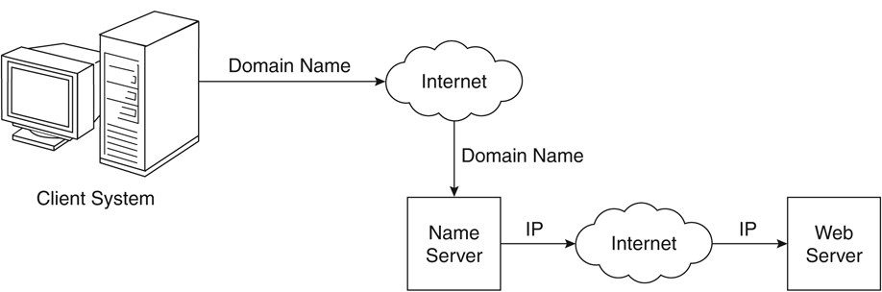
Figure 1.1 Domain name conversion

Slide 3
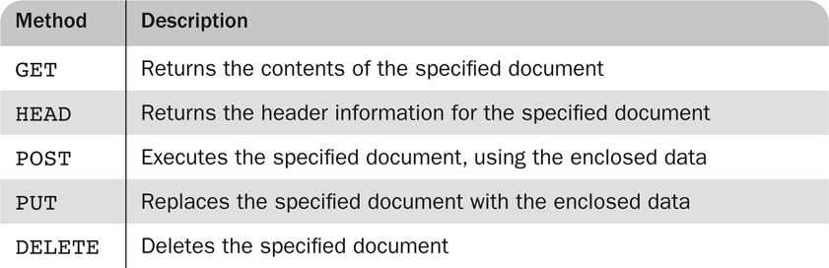
Table 1.1 HTTP Request Methods

Slide 4
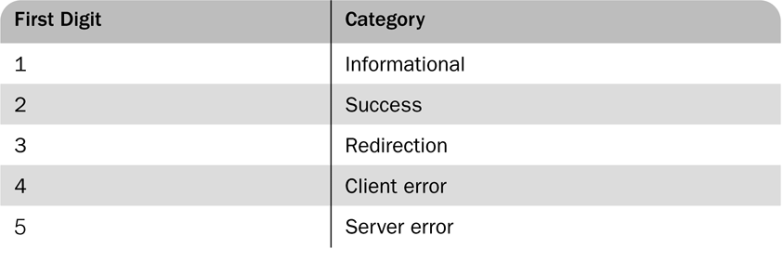
Table 1.2 First Digits of HTTP
Status Codes

